Slide 1

Azure AI Fundamentals (AI 900) – Introduction
Prepared By:
Mind Hacks
Notes:
1
1

Slide 2
Content
Azure AI 900 Syllabus guide
Azure 900: Content Overview
Certification Overview

Slide 3
AZ-900: Syllabus Guide
Exam Link:
Exam AI-900: Microsoft Azure AI Fundamentals - Certifications | Microsoft Learn
We can access the above link to get the
AI-900 study guide – Complete syllabus is mentioned in the link.
Schedule with Pearson VUE – To schedule the exam.
Take a free practice assessment – Once our preparation is completed, before we take the exam we can take the free assessments.
Self paced – We can view all the study concepts from the exam point of view.
Syllabus:
Describe Artificial Intelligence workloads and considerations (15–20%)
Describe fundamental principles of machine learning on Azure (20–25%)
Describe features of computer vision workloads on Azure (15–20%)
Describe features of Natural Language Processing (NLP) workloads on Azure (15–20%)
Describe features of generative AI workloads on Azure (15–20%)

Slide 4
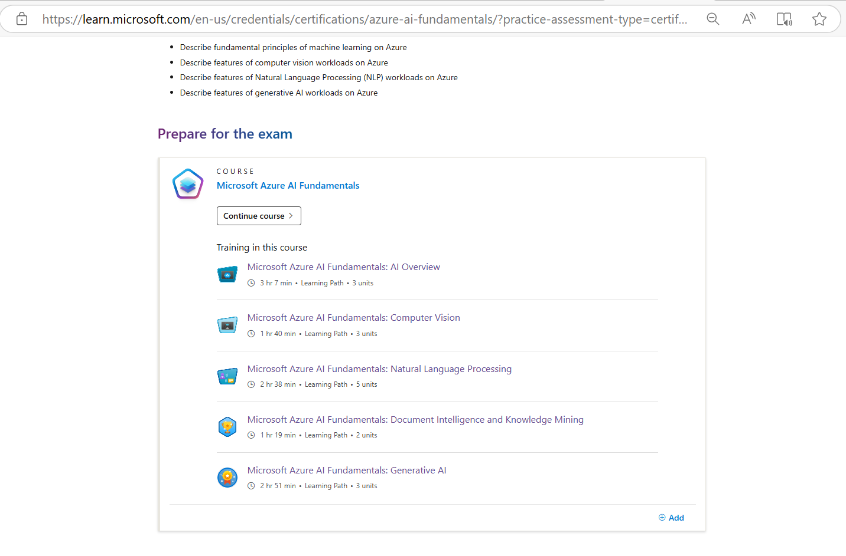
Continued..

Slide 5
AZ-900: Content Overview
Microsoft Azure AI Fundamentals:
Fundamental AI Concepts
Fundamentals of Machine Learning
Fundamentals of Azure AI Services
2. Microsoft Azure AI Fundamentals: Computer Vision
Fundamentals of Computer Vision
Fundamentals of Facial Recognition
Fundamentals of Optical Character Recognition
3. Microsoft Azure AI Fundamentals: Natural Language
Fundamentals of Text Analysis with the language Service
Fundamentals of question answering with the Language Service
Fundamentals of conversational language understanding
Fundamentals of Azure AI Speech

Slide 6
Continued..
4. Microsoft Azure AI Fundamentals: Document Intelligence and Knowledge Mining
Fundamentals of Azure AI Document Intelligence
Fundamentals of Knowledge Mining with Azure Cognitive Search
5. Microsoft Azure AI Fundamentals: Generative AI
Fundamentals of Generative AI
Fundamentals of Azure OpenAI Service
Fundamentals of Responsible Generative AI

Slide 7
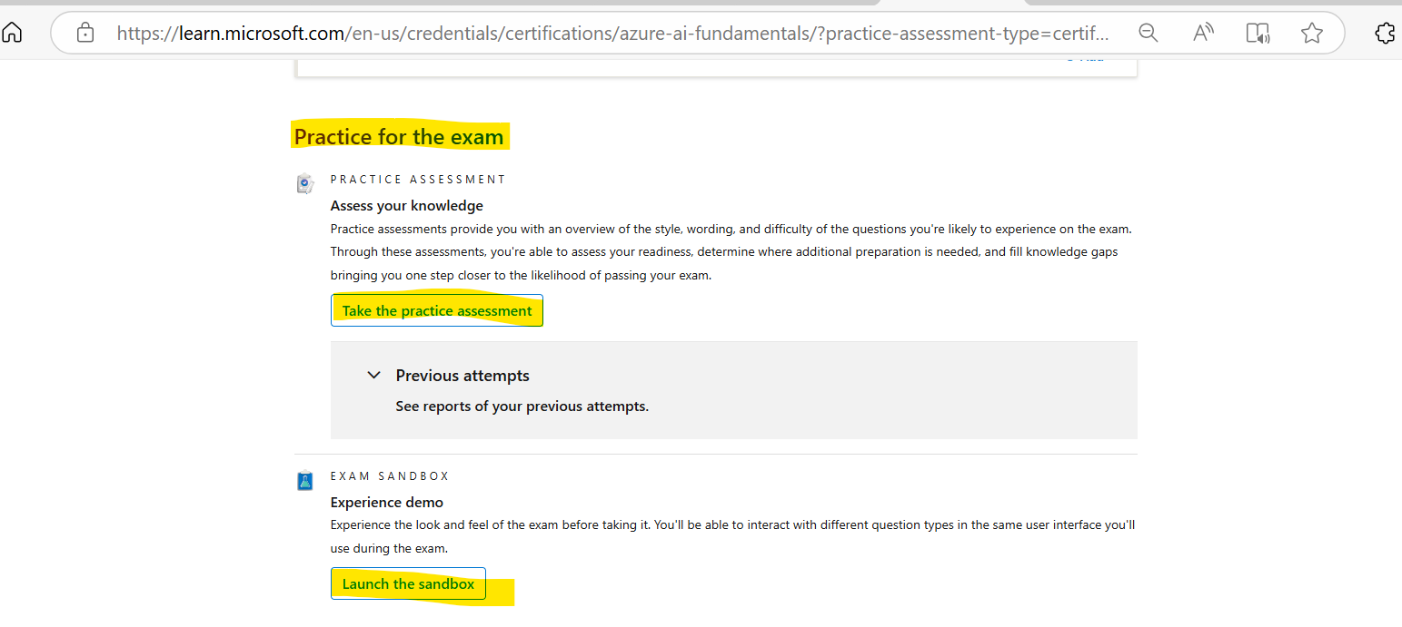
Certification Overview
Once the preparation is completed, take the free assessment before appear for the actual exam.
Path for Free Assessments:
As part of the free assessment, we will be getting 50 questions and as soon as we complete we can view the score.
Actual Exam:
Number of questions varies from 30 to 50.
Score: 1000 (Passing score is >700), Time: 65 Minuets.
Type of the questions: Multiple choice, Drag and drop the correct answer, Match the following, Define true or false.
Exam day we should be in video and audio turn on throughout and we should show one of the ID proof during the exam.

Slide 8
Thanks

